Slide 1

Foundations of Business Intelligence: Databases and Information Management
Chapter 6
Ali Bazarah
MIS 300

Slide 2
Learning Objectives
6.1 What is a database, and how does a relational database organize data?
6.2 What are the principles of a database management system?
6.3 What are the principal tools and technologies for accessing information from databases to improve business performance and decision making?

Slide 3
What is a Database?
Database:
Collection of related files containing records on people, places, or things
Entity:
Generalized category representing person, place, thing
E.g., SUPPLIER, PART
Attributes:
Specific characteristics of each entity:
SUPPLIER name, address
PART description, unit price, supplier

Slide 4
Relational Databases
Organize data into two-dimensional tables (relations) with columns and rows
One table for each entity:
E.g., (CUSTOMER, SUPPLIER, PART, SALES)
Fields (columns) store data representing an attribute
Rows store data for separate records, or tuples
Key field: uniquely identifies each record
Primary key

Slide 5
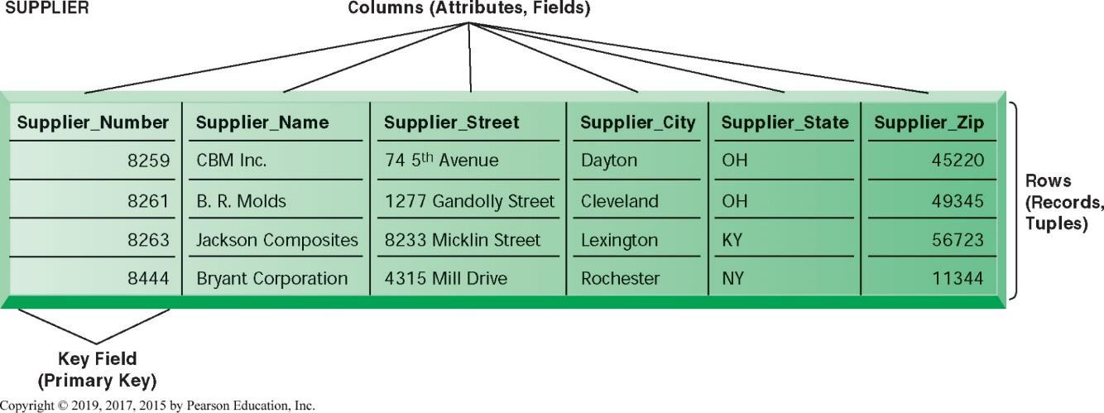
Figure 6.2 A Relational Database Table
Notes:
Figure 6.2, Page 199.
A relational database organizes data in the form of two-dimensional tables. Illustrated here is a table for the entity SUPPLIER showing how it represents the entity and its attributes. Supplier_Number is the key field.

Slide 6
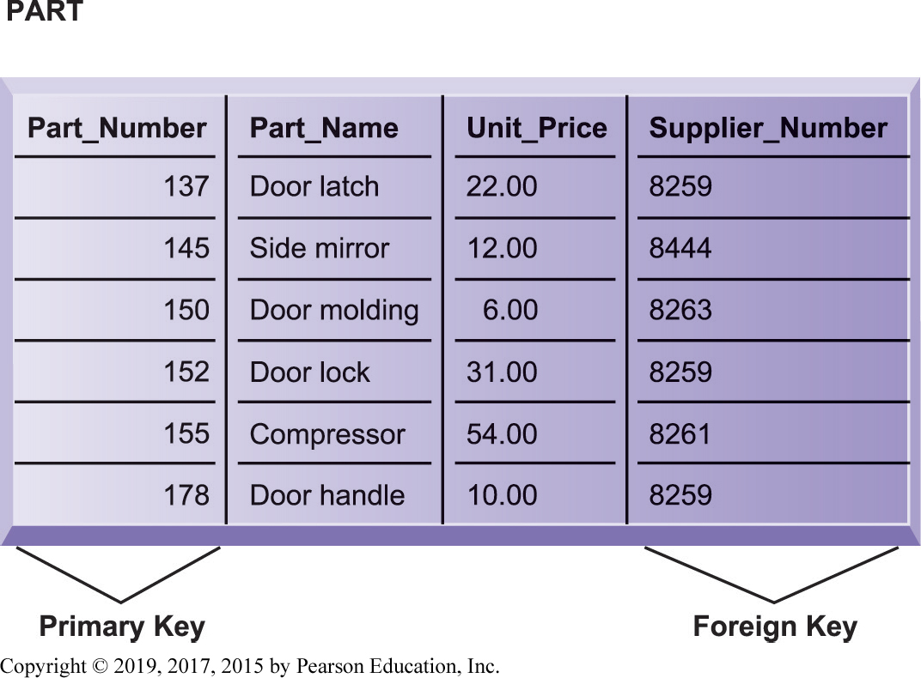
Figure 6.3 The PART Table
Notes:
Figure 6.3, Page 199.
Data for the entity PART have their own separate table. Part_Number is the primary key and Supplier_Number is the foreign key, enabling users to find related information from the SUPPLIER table about the supplier for each part.

Slide 7
Establishing Relationships (1 of 2)
Entity-relationship diagram
Used to clarify table relationships in a relational database
Relational database tables may have:
One-to-one relationship
One-to-many relationship
Many-to-many relationship
Requires “join table” or intersection relation that links the two tables to join information

Slide 8

Figure 6.4 A Simple Entity-Relationship Diagram
Notes:
Figure 6.4, Page 200.
This diagram shows the relationship between the entities SUPPLIER and PART.

Slide 9
Establishing Relationships (2 of 2)
Normalization:
is the process of creating small data structures from complex groups of data when designing a relational database.
Minimizes redundant data elements
Minimizes awkward many-to-many relationships
Increases stability and flexibility
Referential integrity rules
Ensure that relationships between coupled tables remain consistent

Slide 10
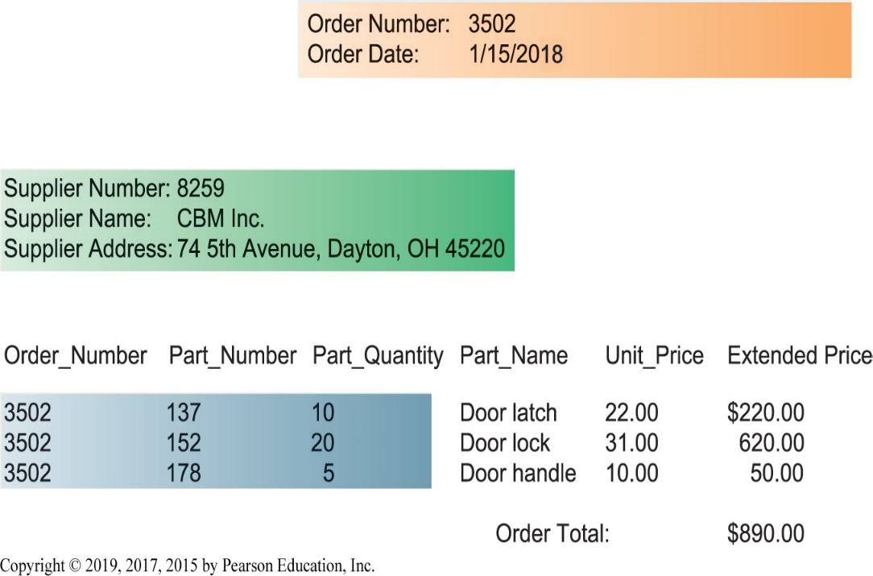
Figure 6.5 Sample Order Report
Notes:
Figure 6.5, Page 201.
The shaded areas show which data came from the ORDER, SUPPLIER, and LINE_ITEM tables. The database does not maintain data on extended price or order total because they can be derived from other data in the tables.

Slide 11
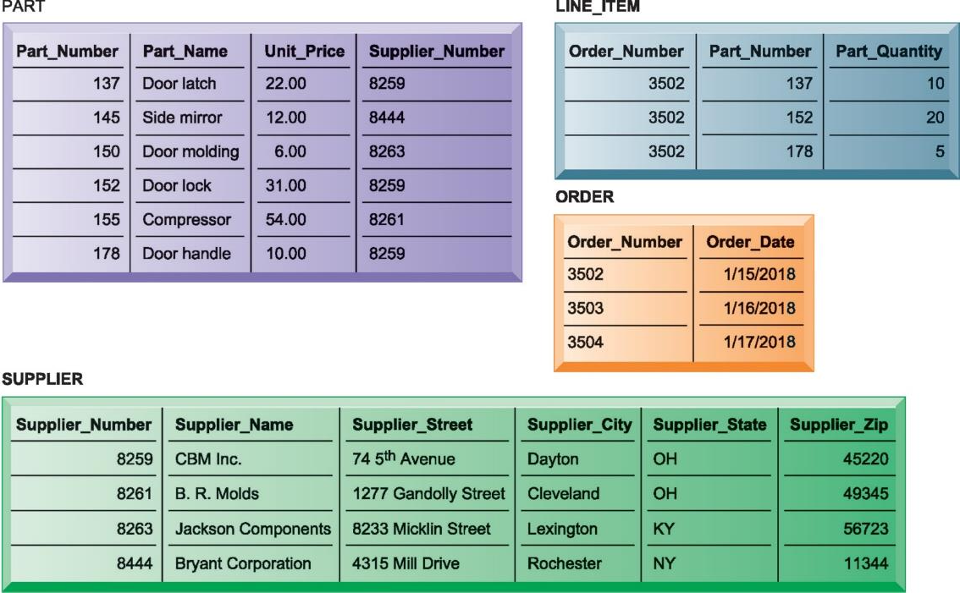
Figure 6.6 The Final Database Design with Sample Records
Notes:
Figure 6.6, Page 202.
The final design of the database for suppliers, parts, and orders has four tables. The LINE_ITEM table is a join table that eliminates the many-to-many relationship between ORDER and PART.

Slide 12

Figure 6.7 Entity-Relationship Diagram for the Database with Four Tables
Notes:
Figure 6.7, Page 203.
This diagram shows the relationship between the SUPPLIER, PART, LINE_ITEM, and ORDER entities.
This graphic shows an example of an entity relationship diagram. It shows that one ORDER can contain many LINE_ITEMs. (A PART can be ordered many times and appear many times as a line item in a single order.) Each LINE ITEM can contain only one PART. Each PART can have only one SUPPLIER, but many PARTs can be provided by the same SUPPLIER.

Slide 13
Database Management Systems (D B M S)
Software for creating, storing, organizing, and accessing data from a database
Separates the logical and physical views of the data
Logical view: how end users view data
Physical view: how data are actually structured and organized
Examples: Microsoft Access, D B 2, Oracle Database, Microsoft S Q L Server, MySQL

Slide 14
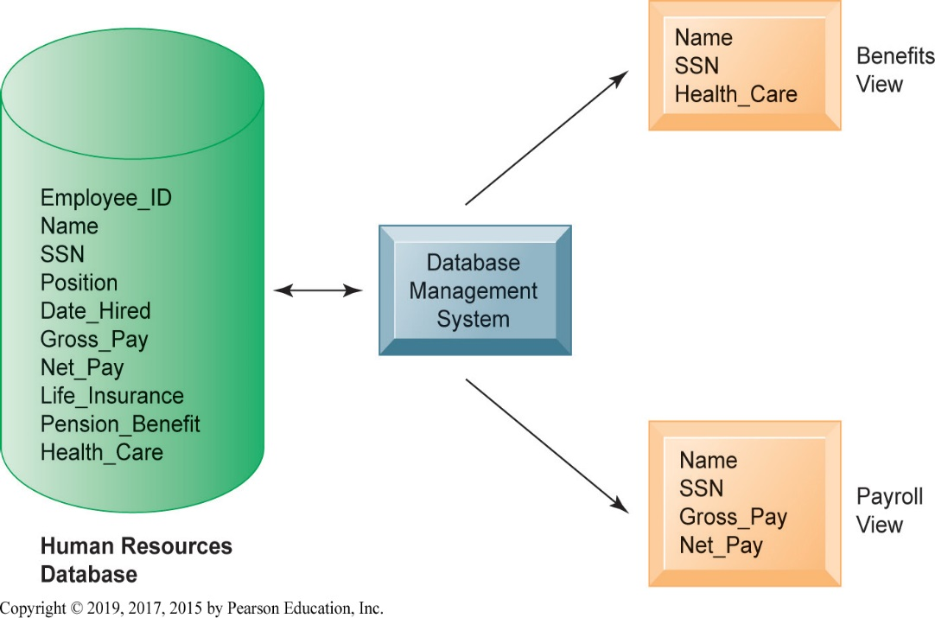
Figure 6.8 Human Resources Database with Multiple Views
Notes:
Figure 6.8, Page 204.
A single human resources database provides many views of data, depending on the information requirements of the user. Illustrated here are two possible views, one of interest to a benefits specialist and one of interest to a member of the company’s payroll department.
This graphic illustrates what is meant by providing different logical views of data. The orange rectangles represent two different views in an HR database, one for reviewing employee benefits, the other for accessing payroll records. The students can think of the green cylinder as the physical view, which shows how the data are actually organized and stored on the physical media. The physical data do not change, but a DBMS can create many different logical views to suit different needs of users.

Slide 15
Operations of a Relational D B M S
Select:
Creates a subset of all records meeting stated criteria
Join:
Combines relational tables to present the server with more information than is available from individual tables
Project:
Creates a subset consisting of columns in a table
Permits user to create new tables containing only desired information

Slide 16
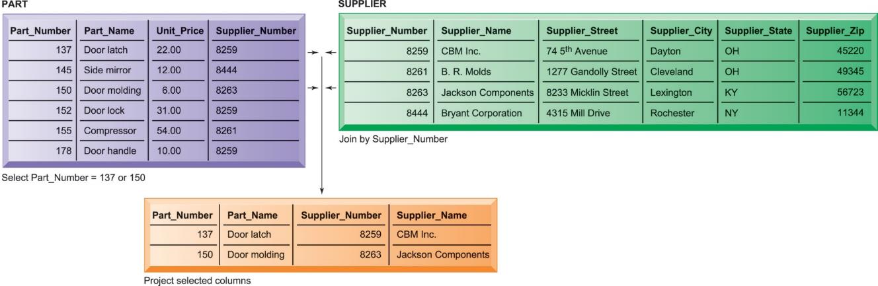
Figure 6.9 The Three Basic Operations of a Relational D B M S
Notes:
Figure 6.9, Page 205.
The select, join, and project operations enable data from two tables to be combined and only selected attributes to be displayed.
This graphic illustrates the result from combining the select, join, and project operations to create a subset of data. The SELECT operation retrieves just those parts in the PART table whose part number is 137 or 150. The JOIN operation uses the foreign key of the Supplier_Number provided by the PART table to locate supplier data from the Supplier Table for just those records selected in the SELECT operation. Finally, the PROJECT operation limits the columns to be shown to be simply the part number, part name, supplier number, and supplier name (orange rectangle).

Slide 17
Capabilities of Database Management Systems
Data definition capabilities:
Specify structure of content of database
Querying and reporting:
Data manipulation language
Structured query language (S Q L)
Microsoft Access query-building tools
Report generation, e.g., Crystal Reports
Notes:
One important function of databases is to bring about common definitions of entities and attributes, like what is a fiscal year, how to express date of hire, and defining “business location.” In pre-database environments, and even in global companies, these definitions vary from one location to another.

Slide 18
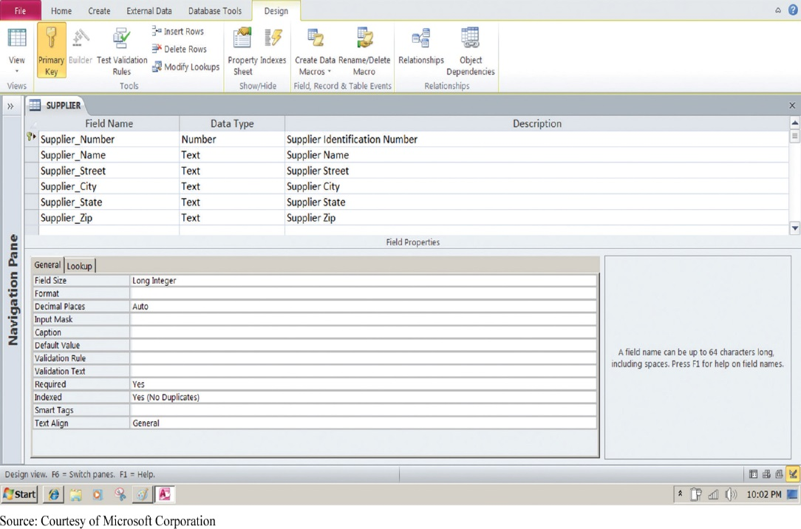
Figure 6.10 Access Data Dictionary Features
Notes:
Figure 6.10, Page 206.
Microsoft Access has a rudimentary data dictionary capability that displays information about the size, format, and other characteristics of each field in a database. Displayed here is the information maintained in the SUPPLIER table. The small key icon to the left of Supplier_Number indicates that it is a key field.
This graphic shows the data dictionary capability of Microsoft Access. For the field “Supplier Name” selected in the top pane, definitions can be configured in the General tab in the bottom pane. These General characteristics are Fields Size, Format, Input Mask, Caption, Default Value, Validation Rule, Validation Text, Required, Allow Zero Length, Indexed, Unicode Compression, IME mode, IME Sentence Mode, and Smart Tags.

Slide 19
Figure 6.11 Example of an S Q L Query
SELECT PART.Part_Number, PART.Part_Name, SUPPLIER.Supplier_Number,
SUPPLIER.Supplier_Name
FROM PART, SUPPLIER
WHERE PART.Suplier_Number = SUPPLIER.Supplier_Number AND
Part_Number = 137 OR Part_Number = 150;
Notes:
Figure 6.11, Page 206.
Illustrated here are the SQL statements for a query to select suppliers for parts 137 or 150. They produce a list with the same results as Figure 6.9.

Slide 20
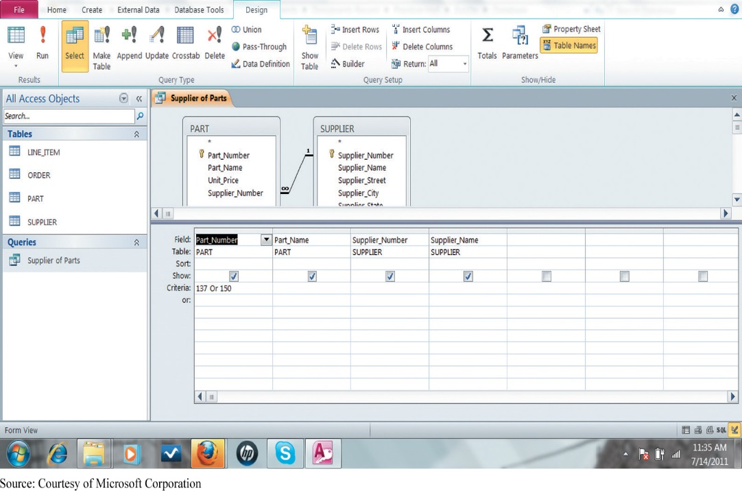
Figure 6.12 An Access Query
Notes:
Figure 6.12, Page 207.
Illustrated here is how the query in Figure 6.11 would be constructed using Microsoft Access query-building tools. It shows the tables, fields, and selection criteria used for the query.
This graphic illustrates a Microsoft Access query that performs the same operation as the SQL query in the last slide. The query pane at the bottom shows the fields that are requested (Fields), the relevant Tables (Table), the fields that will be displayed in the results (Show), and the criteria limiting the results to Part numbers 137 and 150 (Criteria).

Slide 21
Non-Relational Databases
“NoSQL”
Handle large data sets of data that are not easily organized into tables, columns, and rows
Use more flexible data model
Don’t require extensive structuring
Can manage unstructured data, such as social media and graphics
E.g. Amazon’s Simple D B, MetLife’s Mongo D B

Slide 22
The Challenge of Big Data
Massive quantities of unstructured and semi-structured data from Internet and more
Big datasets offer more patterns and insights than smaller datasets, e.g.
Customer behavior
Weather patterns
Requires new technologies and tools

Slide 23
Business Intelligence Infrastructure
Array of tools for obtaining useful information from internal and external systems and big data
Data warehouses
Data marts
Hadoop
In-memory computing
Analytical platforms
Notes:
Modern databases can store enormous amounts of information. Consider that PhotoBucket has 80 billion photos on tap! Yet making sense out of all this data is a challenge for managers. What’s needed are tools to organize the data, analyze, and describe what’s happening in the real world based on the data.

Slide 24
Data Warehouses
Data warehouse:
Database that stores current and historical data that may be of interest to decision makers
Consolidates and standardizes data from many systems, operational and transactional databases
Data can be accessed but not altered
Data mart:
Subset of data warehouses that is highly focused and isolated for a specific population of users
Notes:
Data warehouses and data marts are two tools that bring data together and move it offline to storage areas where it can be analyzed without interfering with the transaction processing systems that produce the data. Data analysis, business intelligence applications, would slow down transaction processing.

Slide 25
Hadoop
Open-source software framework for big data
Breaks data task into sub-problems and distributes the processing to many inexpensive computer processing nodes
Combines result into smaller data set that is easier to analyze

Slide 26
In-Memory Computing
Relies on computer’s main memory (RAM) for data storage
Eliminates bottlenecks in retrieving and reading data
Dramatically shortens query response times
Enabled by high-speed processors, multicore processing
Lowers processing costs

Slide 27
Analytic Platforms
Preconfigured hardware-software systems
Designed for query processing and analytics
Use both relational and non-relational technology to analyze large data sets
Include in-memory systems, NoS Q L D B M S
E.g. I B M Pure Data System for Analytics
Integrated database, server, storage components

Slide 28
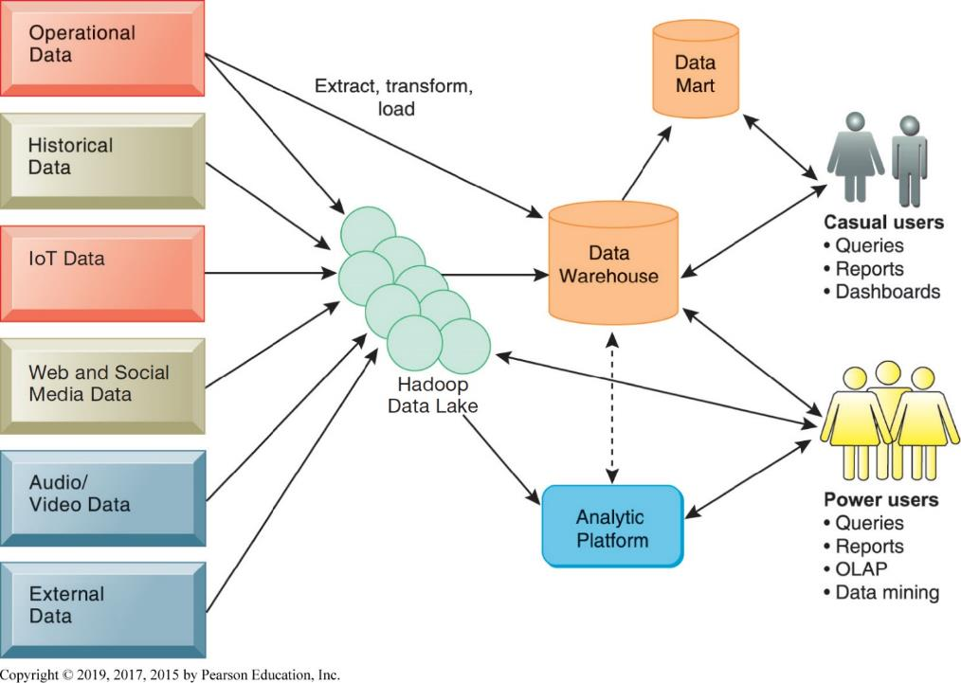
Figure 6.13 Business Intelligence Technology Infrastructure
Notes:
Figure 6.13, Page 213.
A contemporary business intelligence technology infrastructure features capabilities and tools to manage and analyze large quantities and different types of data from multiple sources. Easy-to-use query and reporting tools for casual business users and more sophisticated analytical toolsets for power users are included.

Slide 29
Analytical Tools: Relationships, Patterns, Trends
Once data is gathered, tools are required for consolidating, analyzing, to use insights to improve decision making
Software for database querying and reporting
Multidimensional data analysis (O L A P )
Data mining

Slide 30
Data Mining
Finds hidden patterns and relationships in large databases and infers rules from them to predict future behavior
Types of information obtainable from data mining
Associations: occurrences linked to single event
Sequences: events linked over time
Classifications: patterns describing a group an item belongs to
Clustering: discovering as yet unclassified groupings
Forecasting: uses series of values to forecast future values
Notes:
With terrorism so much in the news, you might ask students how they imagine federal officials use data mining to identify potential or actual terrorists. For instance, if one was looking for terrorists, what kinds of associations, sequences, classifications, and clusters would you look for.

Slide 31
Text Mining
Unstructured data (mostly text files) accounts for 80 percent of an organization’s useful information.
Text mining allows businesses to extract key elements from, discover patterns in, and summarize large unstructured data sets.
Sentiment analysis
Mines online text comments online or in email to measure customer sentiment

Slide 32
Web Mining
Discovery and analysis of useful patterns and information from the web
E.g. to understand customer behavior, evaluate website, quantify success of marketing
Content mining – mines content of websites
Structure mining – mines website structural elements, such as links
Usage mining – mines user interaction data gathered by web servers

Slide 33
Databases and the Web
Firms use the web to make information from their internal databases available to customers and partners.
Middleware and other software make this possible
Web server
Application servers or Common gateway interface (CG I)
Database server
Web interfaces provide familiarity to users and savings over redesigning legacy systems.

Slide 34
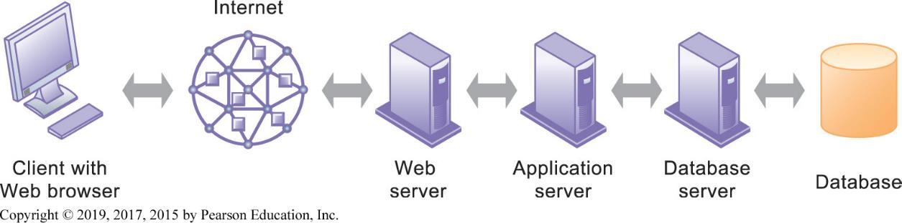
Figure 6.15 Linking Internal Databases to the Web
Notes:
Figure 6.15, Page 216.
Users access an organization’s internal database through the web, using their desktop PCs or mobile devices and web browser software.
This graphic illustrates the way data is passed from a database through to a user with a Web browser. Ask students to describe what types of data transformation occur between the various appliances; for example, what happens to data between the database and the database server?

Slide 35
Ensuring Data Quality
Poor data quality: major obstacle to successful customer relationship management
Data quality problems caused by:
Redundant and inconsistent data produced by multiple systems
Data input errors
Data quality audit
Notes:
Databases are often collections of dirty data, data that is ambiguous, inaccurate, or incomplete. Before a modern DBMSD system is installed, one large budget item is usually cleaning up the old data in old systems. The size of data quality problems varies from one database to another, but credit record databases usually exhibit a 25 percent rate of quality problems, with 10 percent of the records actually being wrong. Ask students if they are aware of instances where a database was wrong about some person or entity.

